Slide 1
MICRO CREDIT LOAN DEFAULTER PROJECT
Submitted by: Amrutha Dhondale

Slide 2
Business Problem
A client in Indonesian Telecom Industry is collaborating with an MFI (Microfinance Institution) to provide micro-credit on mobile balances to be paid back in 5 days. The Consumer is believed to be defaulter if he deviates from the path of paying back the loaned amount within the time duration of 5 days.
In order to improve the selection of customers for the credit, the client wants some predictions that could help them in further investment and improvement in selection of customers.

Slide 3
MOTIVATION FOR THE PROJECT
Based on data provided from our client database, customer’s repayment of loan is assessed based on different factors. By building the model, we can assess which customers are highly likely to repay the loan, thereby it will be useful for those needy people who will repay the loan and also prevent the loss to the customer by avoiding loans to the defaulters.

Slide 4
EDA
Data preprocessing is a technique of converting raw data into useful format.
Data cleaning is a part of pre-processing technique where missing values will be dealt.
Msisdn column will be dropped as it contains phone number of customer and it wont impact the predictions.
Pcircle column will be dropped as it has same entry in all the columns.
Pdate column will be divided into 3 separate columns named year month and date.
The year column has only 1 value(i.e 2016)in all rows so deleting the year column.

Slide 5
We can note that there are few columns with negative values.
1)aon
2)daily_decr30=>Daily amount spent from main account, averaged over last 30 days (in Indonesian Rupiah)
3)daily_decr90=>Daily amount spent from main account, averaged over last 90 days (in Indonesian Rupiah)
4)rental30=>Average main account balance over last 30 days
5)rental90=>Average main account balance over last 90 days
6)last_rech_date_ma=>Number of days till last recharge of main account
7)last_rech_date_da=>Number of days till last recharge of data account

Slide 6
Converting the aon column to positive.
last_rech_date_ma, last_rech_date_da : these two columns indicate no.of days till last recharge of main and data accounts. This count of days also can’t be negative. These columns will be converted to positive.
Rental_30 and rental_90 columns indicate average main account balance over 30 and 90 days respectively.
When these columns are observed, We can note that even though the average rental balance is in negatives which means the customer owe rent to company,
they did repay their loans, which is most unlikely.
There might be other possibility that user will not be granted loan if they have negative balance. The negative entries in the two columns might be due to erroneous entry. So converted them to positive.
It has been mentioned that maxamnt_loans30 columns values has to be either 6 or 12.we can notice that there are huge no. of entries other than 6,12. Ignoring 0 because there might be users who hasn’t taken loans. Converting the other numbers to zero because there is no probability of loan repay amount other than 6 ad 12.There are 1047 rows that has values other than 6,12 and 0. There are 1047 records of values that are other than 6,12 and 0.Converted these 1047 records to zero because we can’t predict their repayment amount.

Slide 7
amt_loans90 column describes the total amount of loans taken by the user in span of 90 days. The presence of zero in this column indicates that the user hasn’t taken any loans.
There are 2043 rows in the data frame with zero in amt_loans90 column. Dropped the rows which has zero in the amt_loans 90 column because such rows wont be useful in predicting the loan repayment.

Slide 8
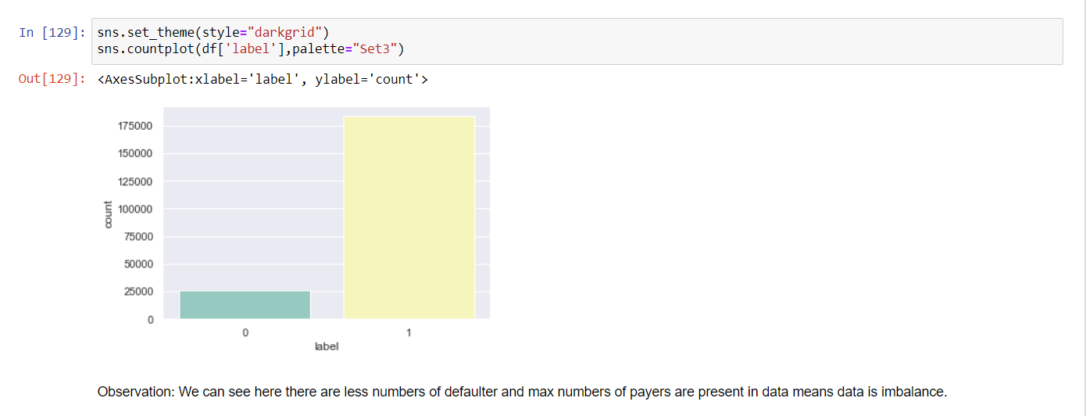
VISUALIZATION

Slide 9
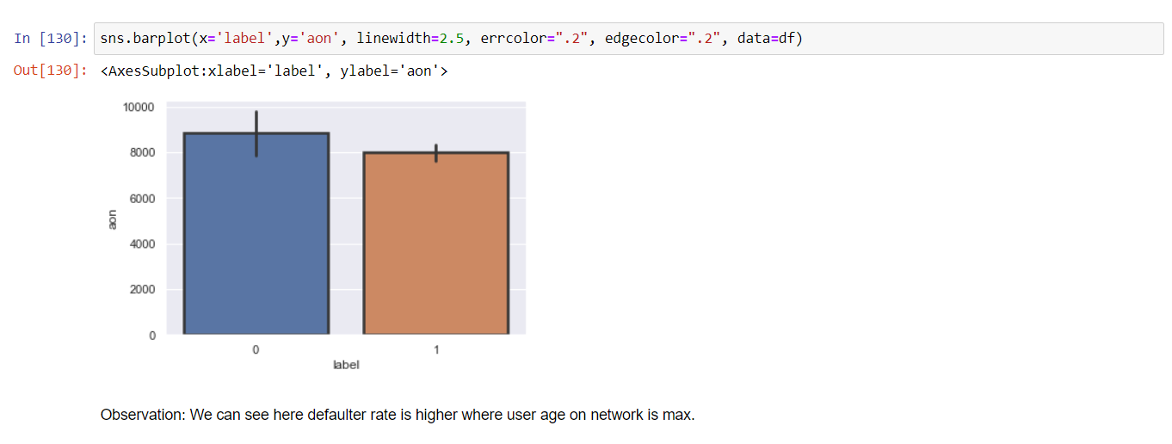

Slide 10
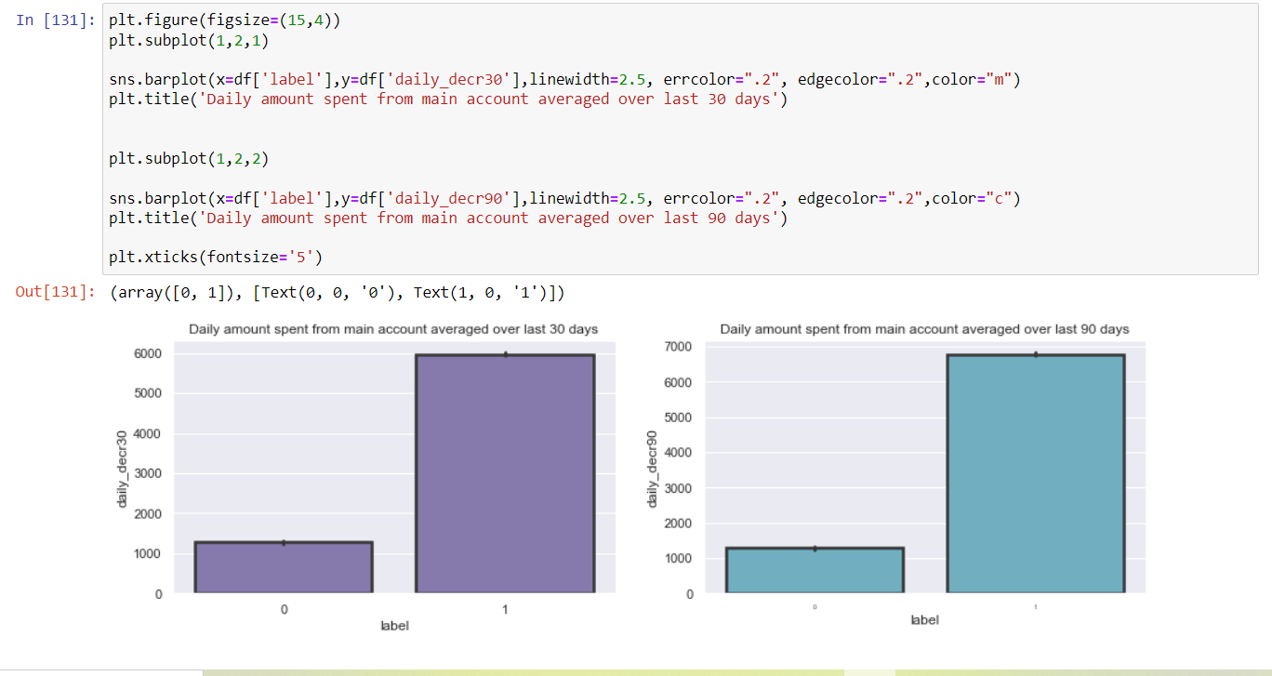
Observation: In repayors, we can see Daily spend average is increasing in last 30 to 90 days

Slide 11
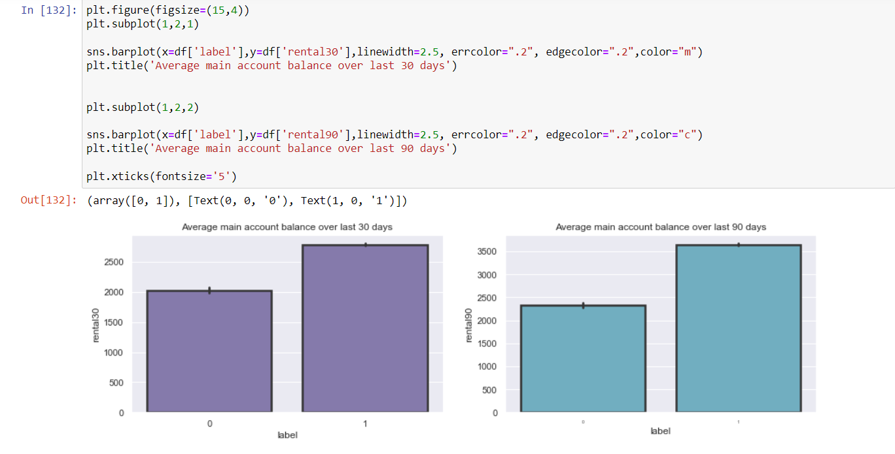
Observation: There are less difference in average main account balance of payers and defaulters, where defaulters count are increasing wherever average main account balance is more in last 30 days. And we check the last 90 days we have more increasing repayors.

Slide 12
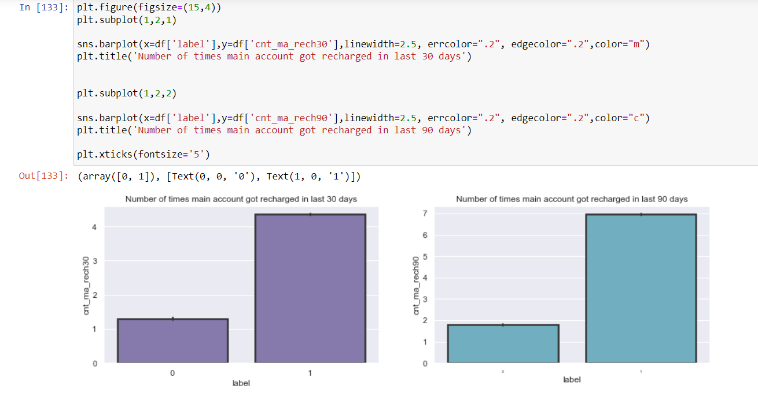
Observation: In 30 days data we can see here an average less than 1 times default user recharging there main account where payers are recharging there main account more than 4 times. When we check last In 90 days data defaulters are recharging upto 2 times and payers are recharging upto 7 times.

Slide 13
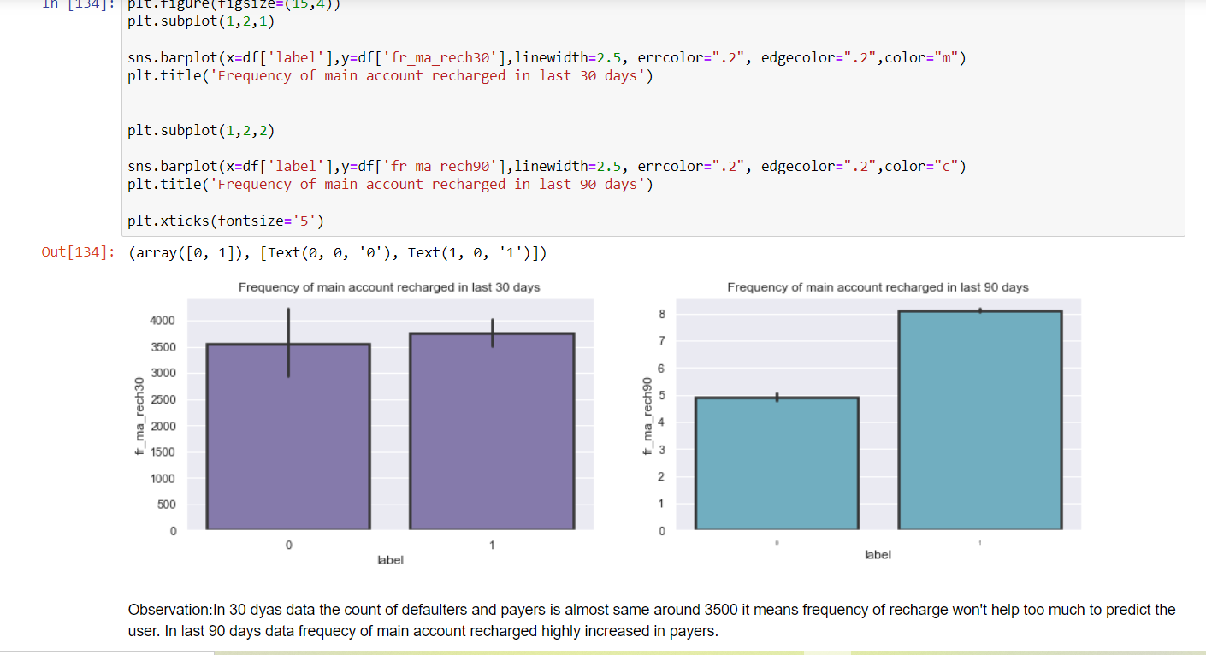

Slide 14
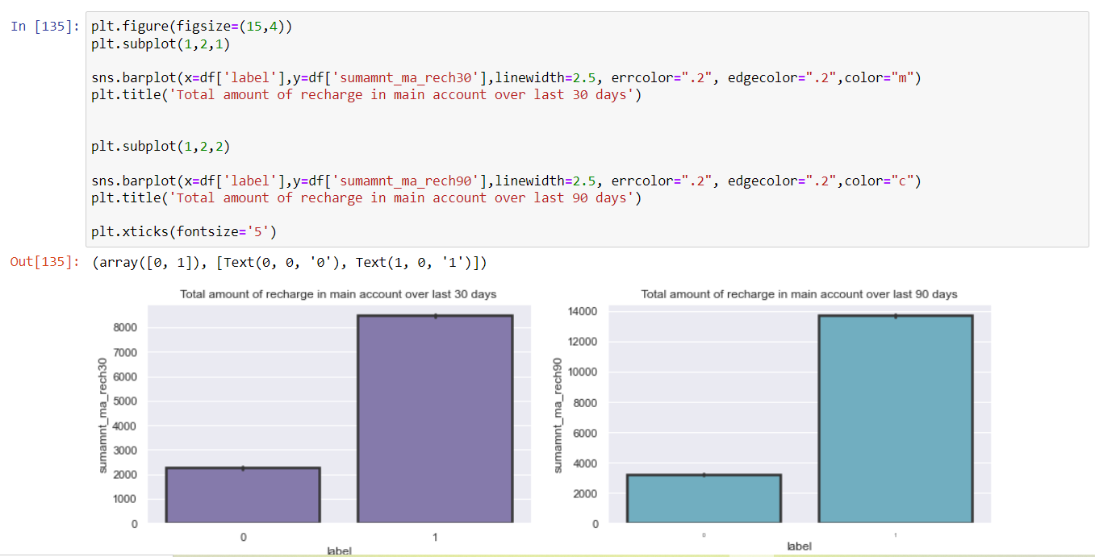

Slide 15
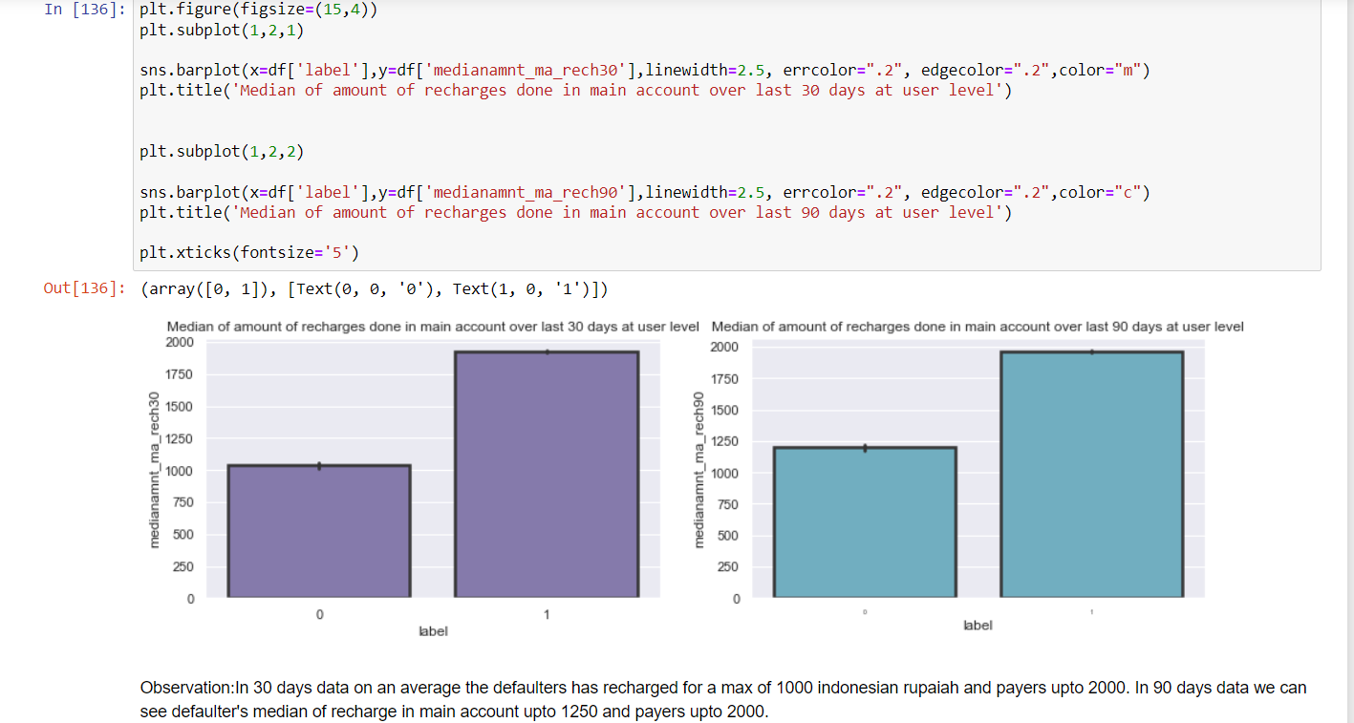

Slide 16
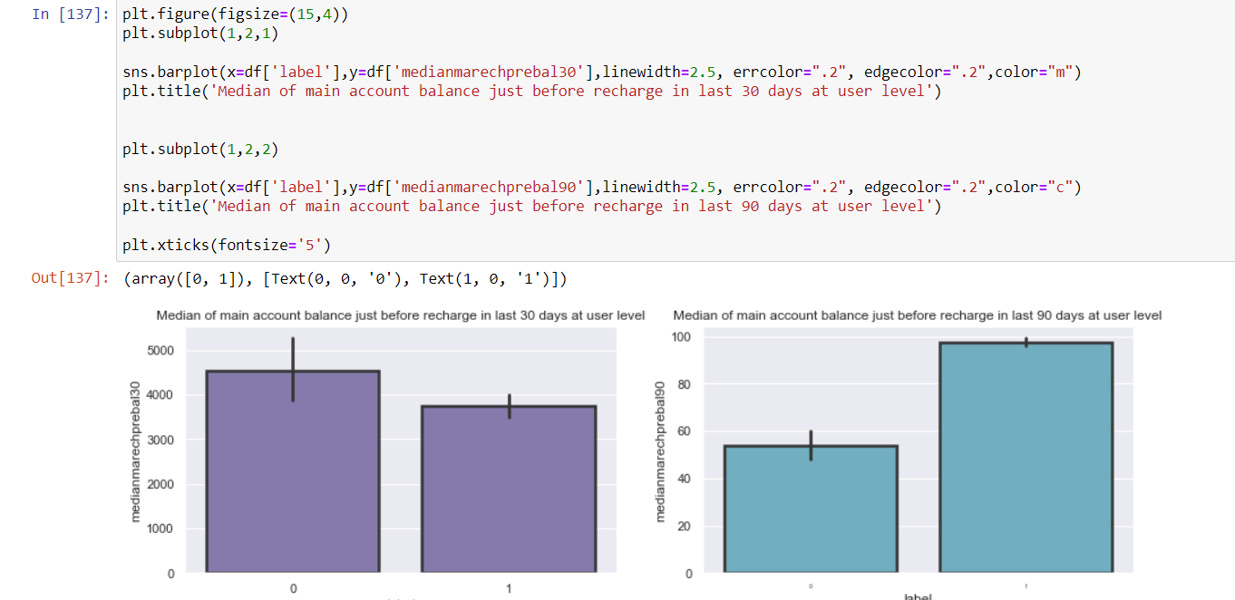
Observation :In 30 days data Median balance main account of defaulters are 4000 to 5000. It means increasing Median of main account balance just before recharge in last 30 days at user level, increasing the probabilities to being defaulter. In 90 days data we see when median is average of 10000 for payers that increasing the probabilities to being payers.

Slide 17
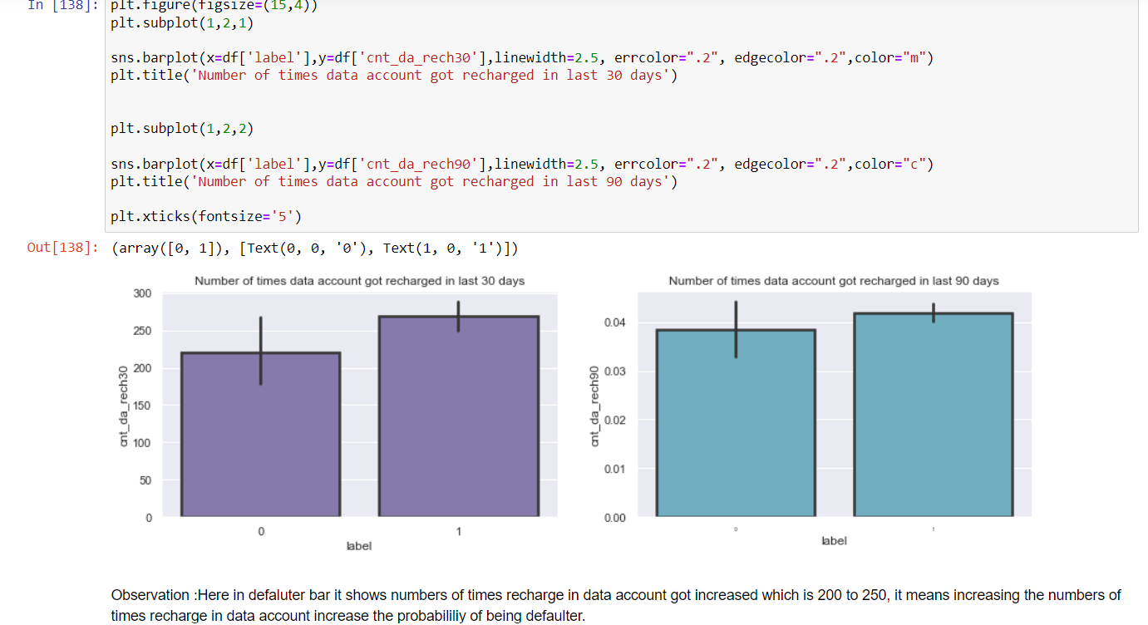

Slide 18
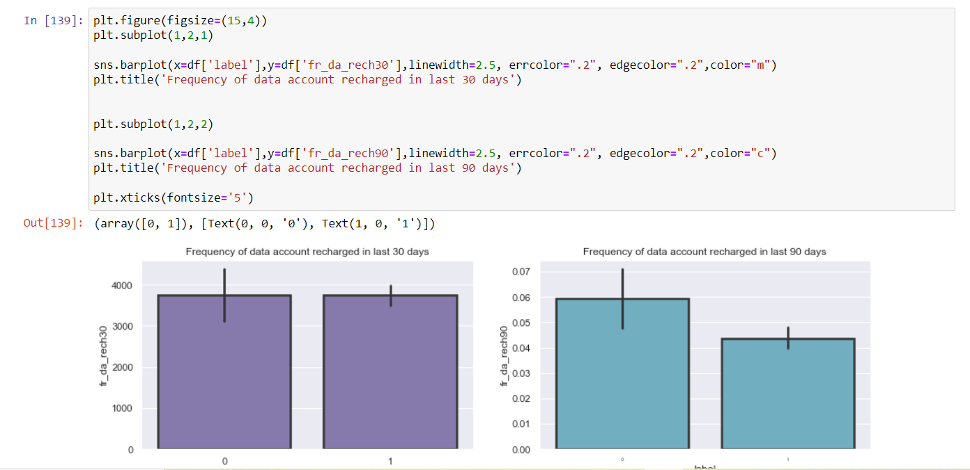
Observation :In 30 days data defaulter bar shows Frequency of data account recharged in last 30 days got increased which is 3000 to 4000.means increasing the Frequency of data account recharged in last 30 days increase the probabilities of being defaulter.. In 90 days data we also notice increasing the Frequency of data account recharged, increase the probabilities of being defaulter.

Slide 19
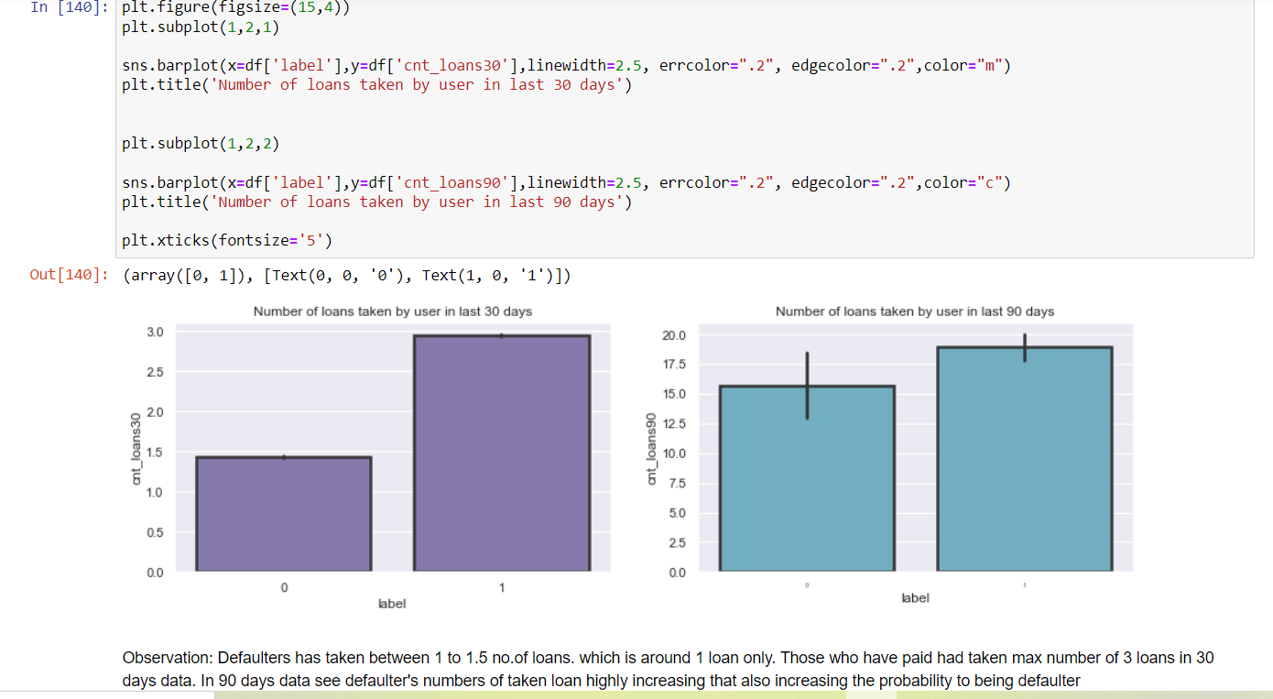

Slide 20
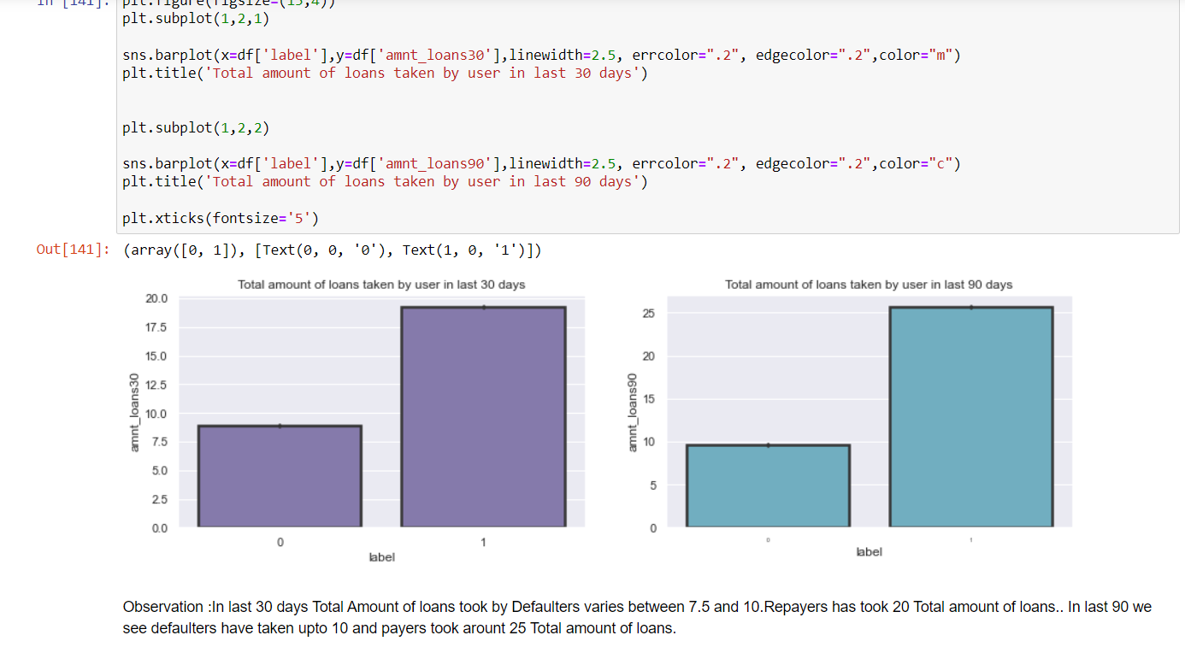

Slide 21
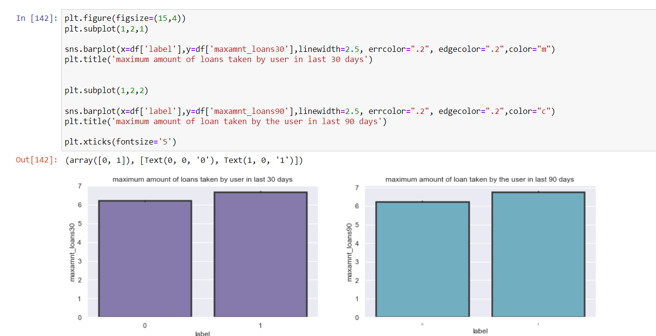
Observation :A user have taken Maximum amount of 6 in last 30 or 90 days, where defaulter and payers both have taken 6-7 amount . Can say that there not a much difference in loans took by both defaulters and repayors.

Slide 22
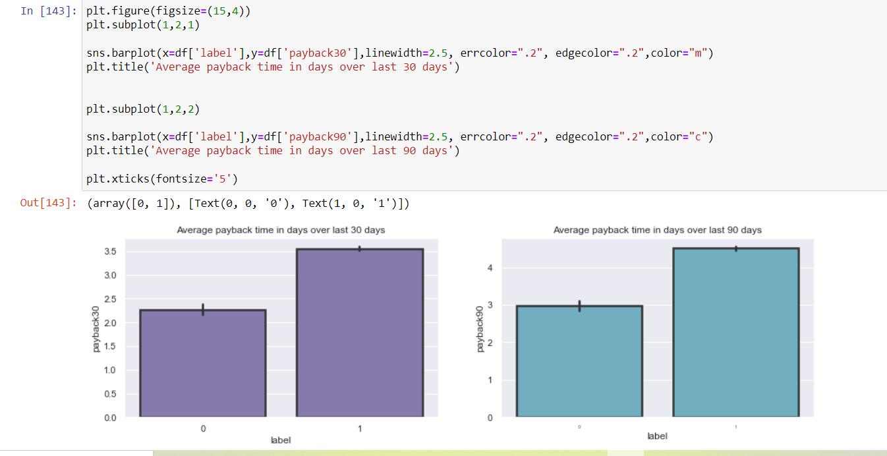
Observation: In last 30 days payers are returning in average of 3.5 days, where defaulters are returning in 2.0 to 2.5 days. In last 90 days payers are returning in 4-5 days and defaulter are returning in 3 days

Slide 23
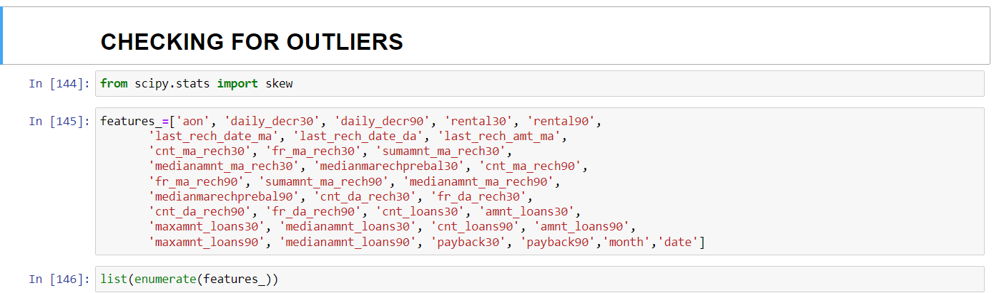
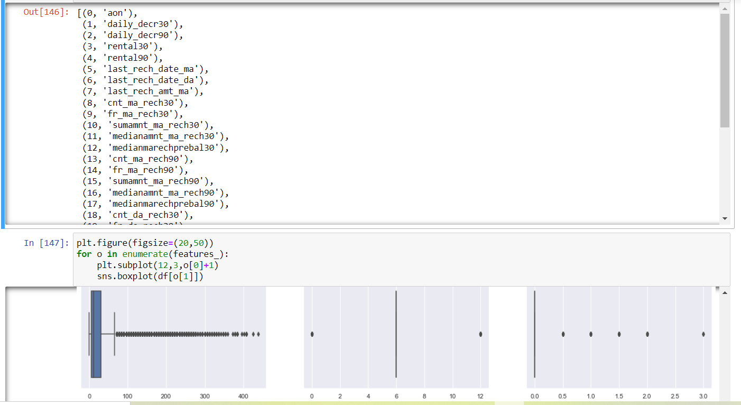

Slide 24
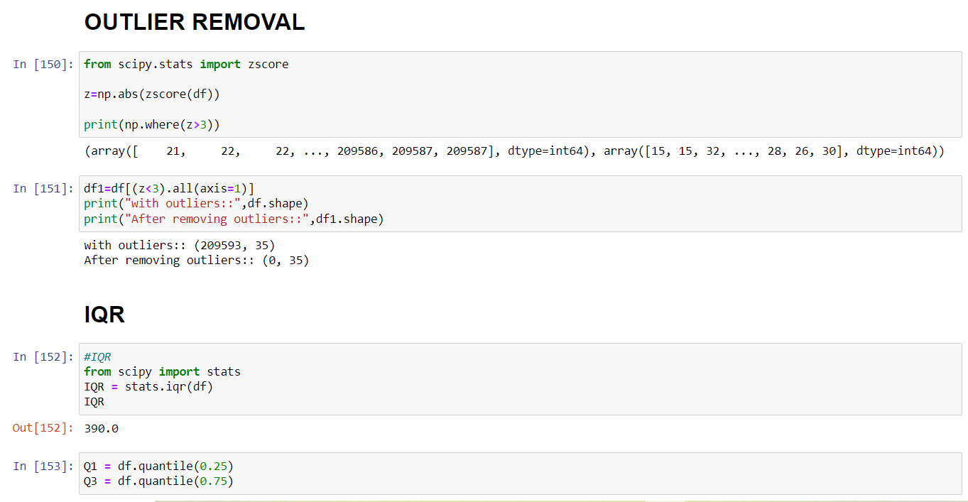
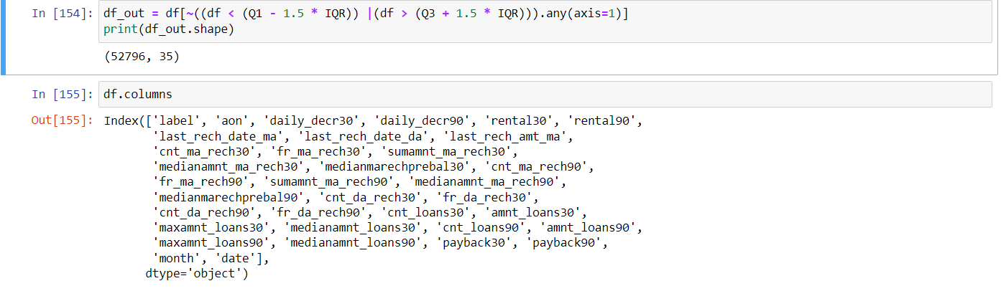

Slide 25
Mostly outliers are removed by either z score or IQR(Inter Quartile Range).Tried both these approaches first but, the data loss is high in both these approaches. It has been mentioned in guidelines that the data loss should not exceed 7%.So applied capping technique which is also called as winsorization.
Another technique is replacing the outlier data with mean or median. But when we observe this data set there is a huge difference between minimum and maximum values. If we calculate mean or median it wont give appropriate values as it includes the outlier value(maximum ones).So not using this approach.
As we are not dropping the outliers, another approach is capping or winsorization of outliers.
using percentile capping. Values that are less than the value at 10th percentile are replaced by 10th percentile value , and values greater than 90th percentile are replaced by 90th percentile value.

Slide 26
Steps before building model
Data should be segregated into x and y
scaling of x values should be done.
skewness removal needs to be done before splitting into train and test sets.

Slide 27
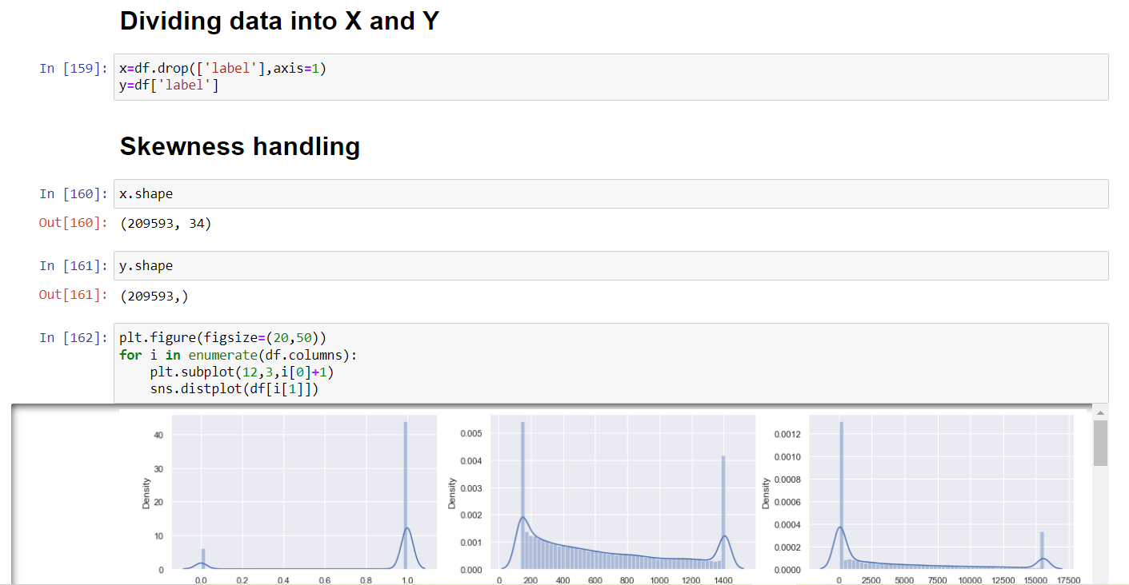

Slide 28
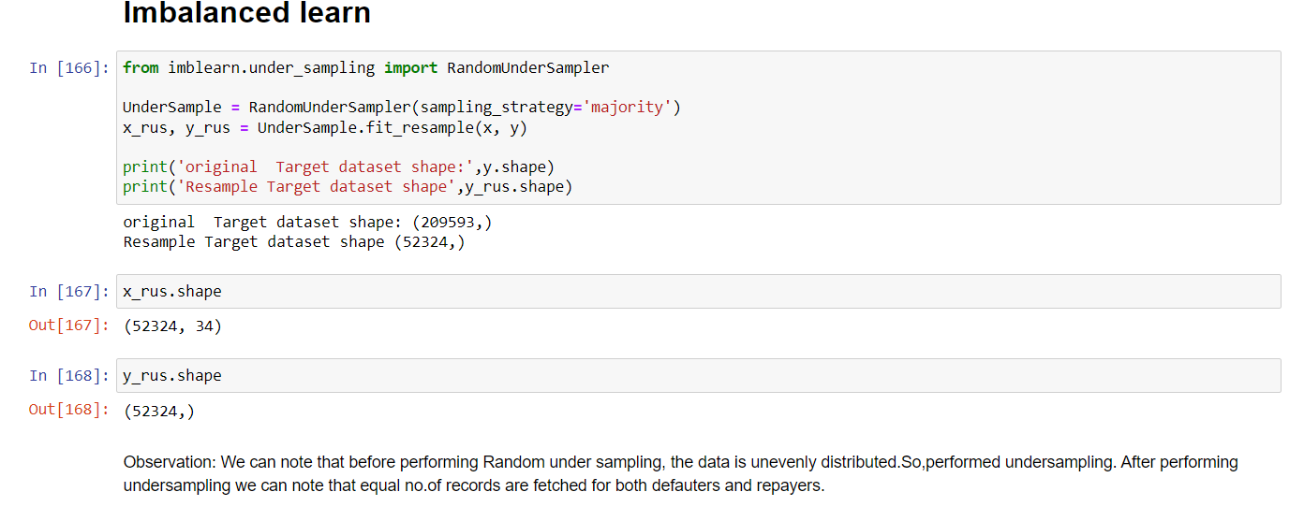
The data set is imbalanced since it has large no. of records which contains data about those repaid the loan and less no. of records of those who defaulted loan.
This might result in biased predictions. So, used imbalance learn library to reduce the imbalances. The imbalance learn library provides different approaches one is Random under sampling. In context of this problem, RandomUnderSampling reduces the no. of records of those who paid the loan. To be precise, RandomUnderSampling deletes data from the majority class such that there will be equal no. of samples of both the classes. Hence reduces the bias.

Slide 29
Algorithms used
I have tried different classification algorithms to check which algorithm performs best.
I did cross validation before fitting a model to avoid over fitting and cross validation also determines a models ability to predict on new data.
List of algorithms used:
Logistic Regression
Decision Tree Classifier
KNeighborsClassifier
RandomForestClassifier
AdaboostClassifier
BaggingClassifier
GradientBoostingClassifier

Slide 30
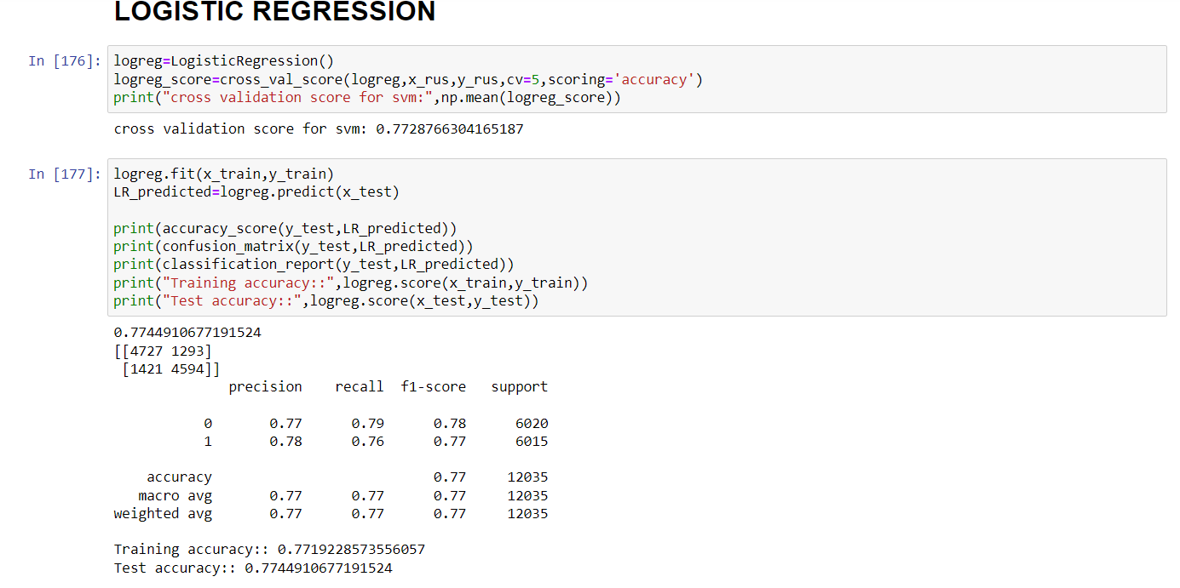

Slide 31
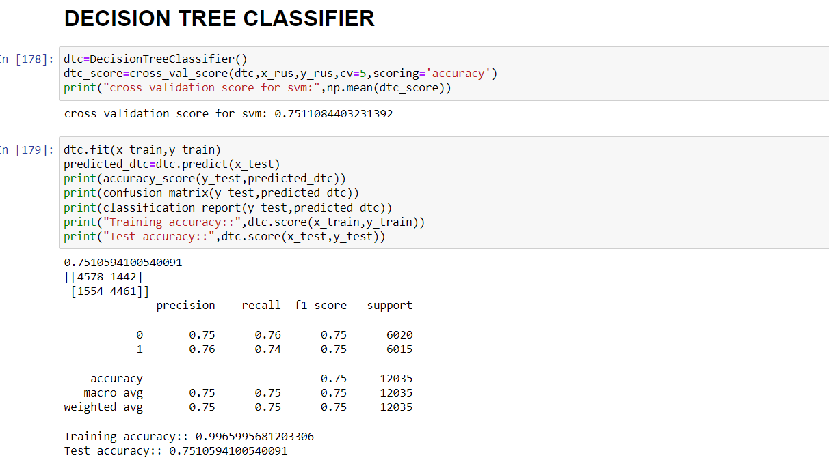

Slide 32
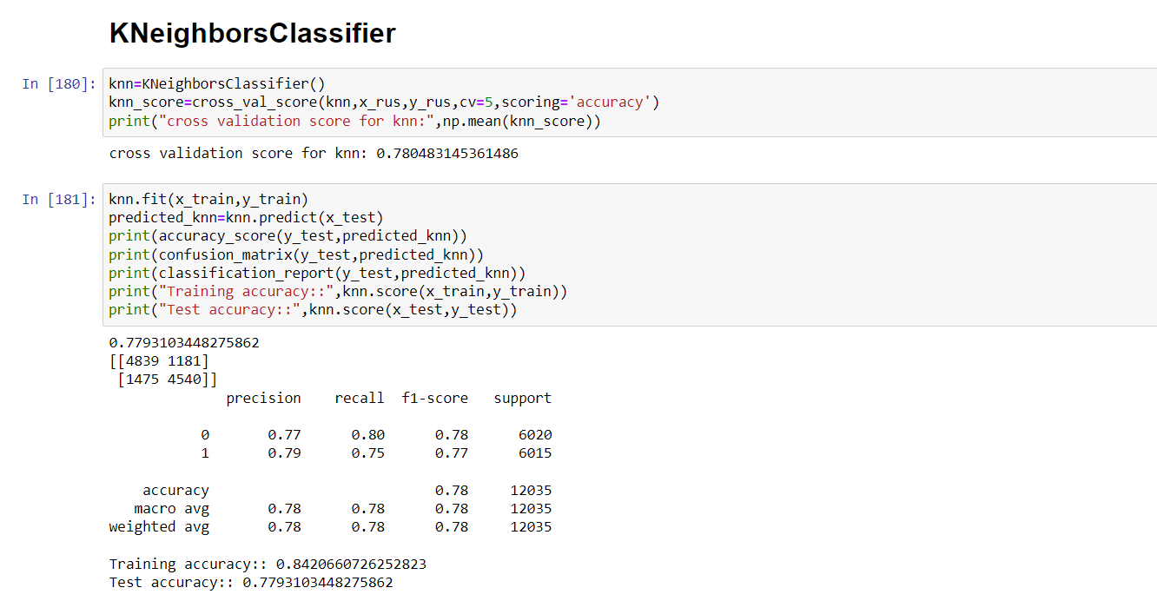

Slide 33
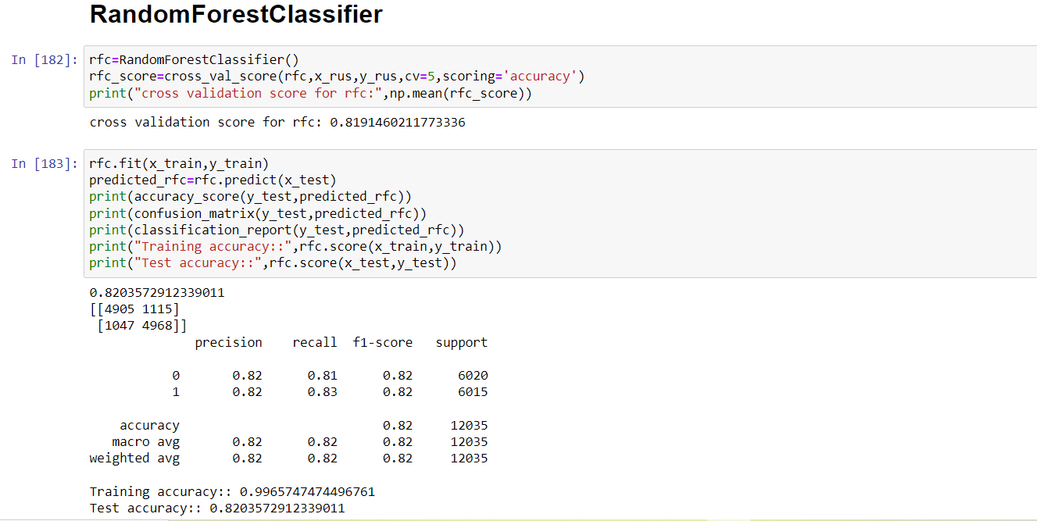

Slide 34
Ensemble models in machine learning operate on a similar idea. They combine the decisions from multiple models to improve the overall performance.
The idea behind bagging is combining the results of multiple models to get a generalized result.
Here I have used the following ensemble techniques.

Slide 35
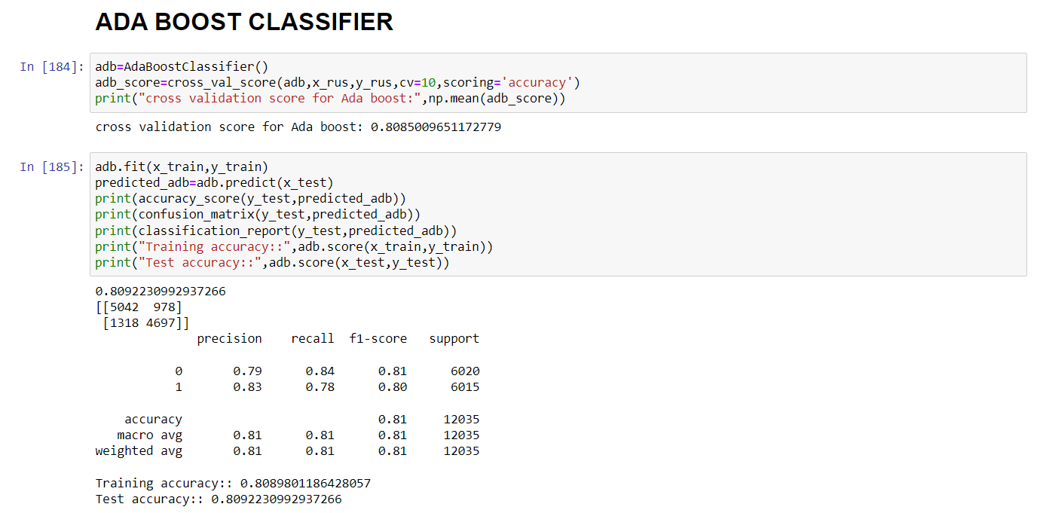

Slide 36
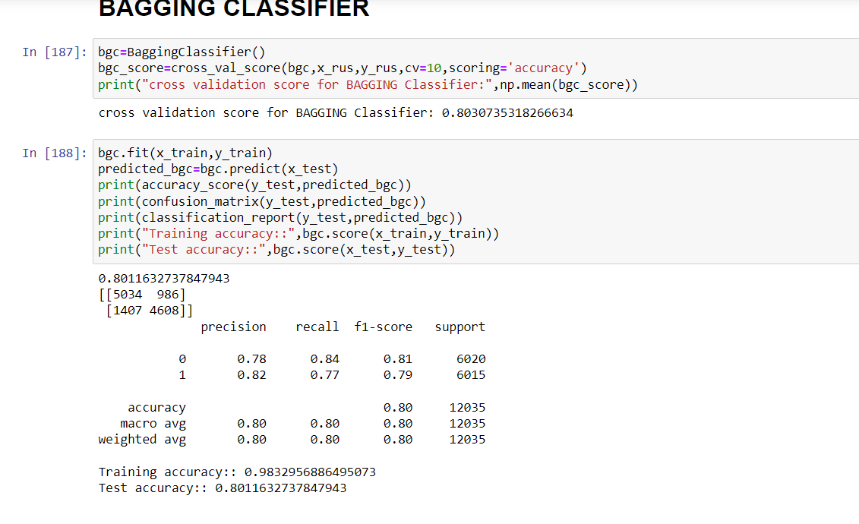

Slide 37
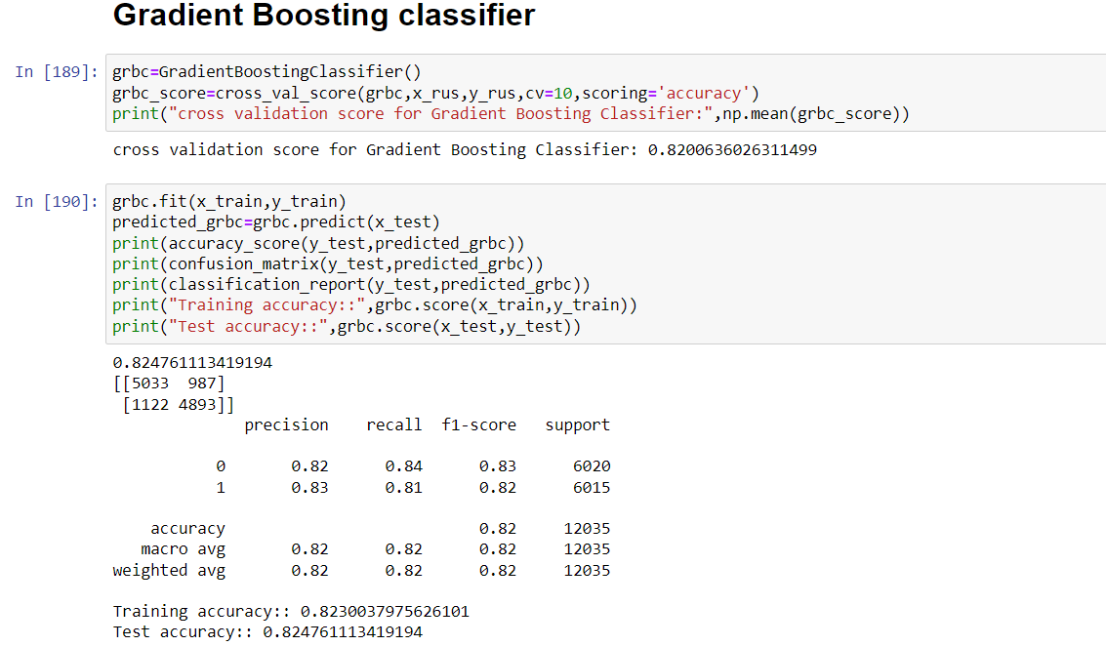

Slide 38
Choosing the Algorithm for Hyper Parameter Tuning
The algorithms are evaluated on different criteria like accuracy, precision, recall
I have chosen
1.Adaboost classifier and
2. GradientBoostingClassifier because there is less difference between train and test accuracies which indicates there will be no over or under fittings.

Slide 39
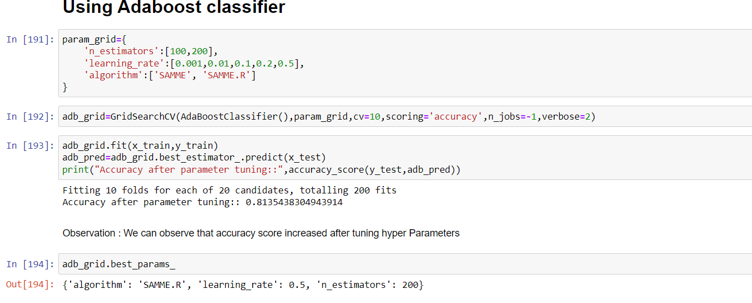
Hyper Parameter Tuning
Hyper parameter tuning is used to increase the performance of the algorithm
Hyper parameter tuning tends to reduce over fitting as well.

Slide 40
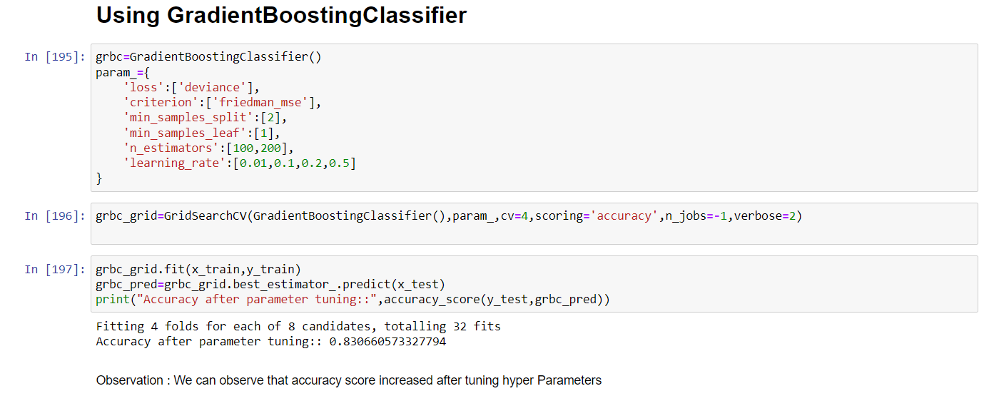

Slide 41
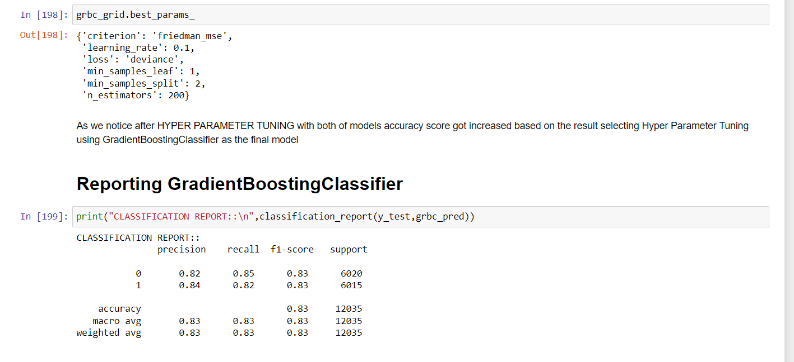

Slide 42
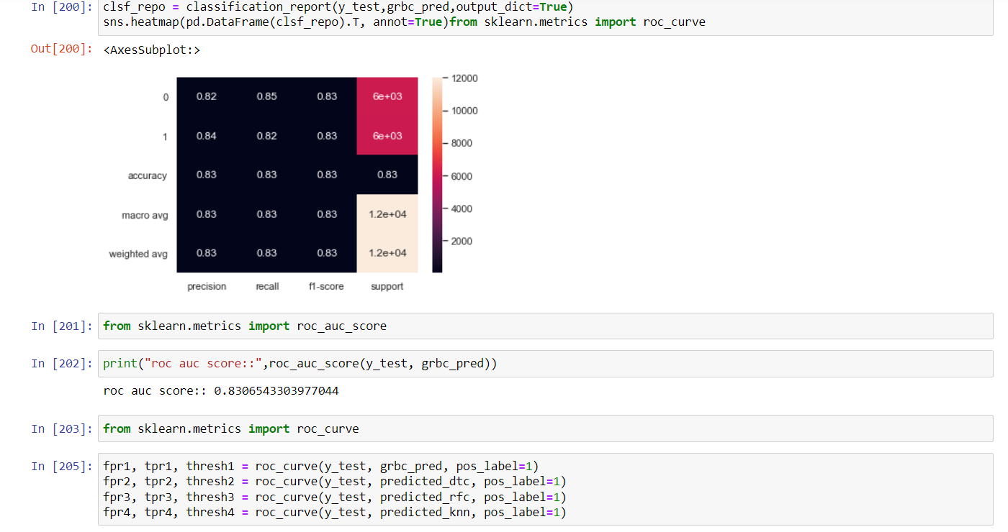

Slide 43
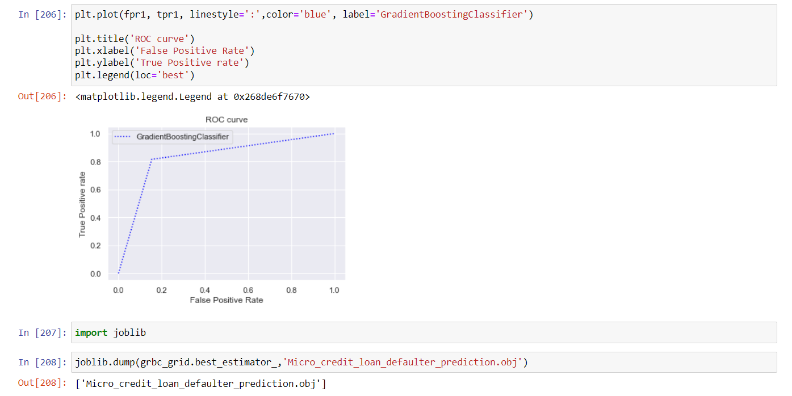

Slide 44
Conclusion:
The model we built predicts whether the customer defaults or not with an accuracy of 83.06%
The defaulting rate is higher in old customers. Defaulters recharge for the main account less no. of times but does recharge for data account more no. of times.
Re payers recharge the main account more no. of times when compared to defaulters.
This data set contains data of the year 2016 belonging to PSW telecom circle.
If we get data of other years along with other telecom companies there will be scope for future work on this project.

